Slide 1



Not familiar with e-Learning? Let the experts at SweetRush tell you all about it!
E-Learning
In 2015, the worldwide market for self-paced eLearning is estimated to be $49.5 Billion. Forbes estimates $107 Billion for 2015.
eLearning is used in 120 countries
Top users are the United States and then China
“The top ten countries with the highest eLearning growth rates in the world are Laos, Thailand, Uganda, Cambodia, Ghana, Rwanda, Mongolia, Myanmar, Senegal, Nepal.
Major drivers of growth: creation and large scale use of MOOCs (Massive Open Online Courses), self-paced eLearning, e-Tutors for the K-12 age group.

Slide 2

eLearning Instructional Designer
About the Job
We are working closely with our client in identifying an Instructional Designer to analyze, design, develop, implement and evaluate a variety of training and educational programs that support the achievement of business objectives. You will work with business partners to create training content and develop course objectives. Your responsibilities are as follows:
Design and create training curriculum, programs and training collateral
Assess existing and emerging technologies and their use in an instructional environment
Design and construct criterion-referenced assessments that address all levels of the Kirkpatrick scale
Create audio scripts, accompanying visuals, practice exercises and assessment measurement tools for training programs
Design and develop eLearning reflecting adult learning theories using Articulate and Captivate
Perform other job-related duties as assigned
Experience Required:
Bachelor’s degree in Instructional Technologies or similar with 3 years’ experience in training design
Proven experience using ADDIE to develop eLearning training
Previous experience with Articulate, Lectora and/or Captivate
Proficient with Microsoft Office suite
Ability to communicate technical information to variety of audiences
Highly collaborative with ability to partner with management and SMEs to achieve business goals
Knowledge of retail concepts, practices and procedures a plus
Notes:
http://jobview.monster.com/eLearning-Instructional-Designer-Job-Jacksonville-FL-US-162839383.aspx?mescoid=2500399001001&jobPosition=2
Jima

Slide 3
eLearning Instructional Designer
About the Job
We are working closely with our client in identifying an Instructional Designer to analyze, design, develop, implement and evaluate a variety of training and educational programs that support the achievement of business objectives. You will work with business partners to create training content and develop course objectives. Your responsibilities are as follows:
Design and create training curriculum, programs and training collateral
Assess existing and emerging technologies and their use in an instructional environment
Design and construct criterion-referenced assessments that address all levels of the Kirkpatrick scale
Create audio scripts, accompanying visuals, practice exercises and assessment measurement tools for training programs
Design and develop eLearning reflecting adult learning theories using Articulate and Captivate
Perform other job-related duties as assigned
Experience Required:
Bachelor’s degree in Instructional Technologies or similar with 3 years’ experience in training design
Proven experience using ADDIE to develop eLearning training
Previous experience with Articulate, Lectora and/or Captivate
Proficient with Microsoft Office suite
Ability to communicate technical information to variety of audiences
Highly collaborative with ability to partner with management and SMEs to achieve business goals
Knowledge of retail concepts, practices and procedures a plus
Benefit from MS LDT:
Skills to be Acquired:
Notes:
http://jobview.monster.com/eLearning-Instructional-Designer-Job-Jacksonville-FL-US-162839383.aspx?mescoid=2500399001001&jobPosition=2
Jima

Slide 4


Penn State University
INSTRUCTIONAL DESIGNER
Department: eLearning Design and Innovation Group (eLDIG)
DESCRIPTION
The Smeal College of Business is seeking an Instructional Designer to join our eLearning Design and Innovation Group (eLDIG). This position utilizes knowledge of learning science and instructional design to assist faculty in the design and development of the College’s online and blended teaching and learning efforts. We are searching for a team player that can work with instructors, the eLDIG team, and a team of multimedia specialists and programmers, to create engaging learning experiences in response to Smeal’s growing online and hybrid education needs. The successful candidate needs to think creatively and have the ability to apply research-based learning theories including needs and task analysis, pedagogical theory, assessment strategies, and best practices for the development of university-level courses.
Responsibilities.
The ability to collaborate and consult with subject matter experts on the effective use of learning strategies, web-based resources, multimedia technologies, and instructional applications and systems to improve teaching and learning for online and blended delivery is essential. The candidate must be able to incorporate current approaches to online learning including problem-based learning and case-based learning and maintain a constant focus on usability and accessibility requirements. The ability to develop course content for use in current and future learning management systems (e.g. ANGEL, Canvas) is fundamental to this position.
A successful candidate must possess strong written, and interpersonal skills and the ability to deal with multiple constituencies in a fast-paced, dynamic, team-based work environment. This job will be filled as a level 2, or level 3, depending upon the successful candidate's competencies, education, and experience. Typically requires a Master's degree or higher plus two years of related experience, or an equivalent combination of education and experience for a level 2. Additional experience and/or education and competencies are required for higher level jobs. At least two years of formal or informal experience designing online and blended courses in a higher education context is preferred. Teaching experience in a K12 or higher education environment and experience with current and emerging learning, communication, and collaboration technologies are also a plus.
Notes:
https://psu.jobs/job/61703
Jima

Slide 5
Penn State University
INSTRUCTIONAL DESIGNER
Department: eLearning Design and Innovation Group (eLDIG)
DESCRIPTION
The Smeal College of Business is seeking an Instructional Designer to join our eLearning Design and Innovation Group (eLDIG). This position utilizes knowledge of learning science and instructional design to assist faculty in the design and development of the College’s online and blended teaching and learning efforts. We are searching for a team player that can work with instructors, the eLDIG team, and a team of multimedia specialists and programmers, to create engaging learning experiences in response to Smeal’s growing online and hybrid education needs. The successful candidate needs to think creatively and have the ability to apply research-based learning theories including needs and task analysis, pedagogical theory, assessment strategies, and best practices for the development of university-level courses.
Responsibilities.
The ability to collaborate and consult with subject matter experts on the effective use of learning strategies, web-based resources, multimedia technologies, and instructional applications and systems to improve teaching and learning for online and blended delivery is essential. The candidate must be able to incorporate current approaches to online learning including problem-based learning and case-based learning and maintain a constant focus on usability and accessibility requirements. The ability to develop course content for use in current and future learning management systems (e.g. ANGEL, Canvas) is fundamental to this position.
A successful candidate must possess strong written, and interpersonal skills and the ability to deal with multiple constituencies in a fast-paced, dynamic, team-based work environment. Typically requires a Master's degree or higher plus two years of related experience, or an equivalent combination of education and experience for a level 2. Additional experience and/or education and competencies are required for higher level jobs. At least two years of formal or informal experience designing online and blended courses in a higher education context is preferred. Teaching experience in a K12 or higher education environment and experience with current and emerging learning, communication, and collaboration technologies are also a plus.
Skills to be Acquired:
Benefit from MS LDT:
Notes:
https://psu.jobs/job/61703
Jima

Slide 6


Discussion
Points
How is the MS in LDT at Purdue preparing you in your Career Pathway?
Are there additional skills you plan to acquire in the field of ID?
Have you searched for ID jobs outside of your current position? What was your experience?
What do you feel is the most important skill you will need and use in the ID field?
Notes:
Jima (audio) The previous Slides were two samples of current job postings in the field of Instructional Design.
One for consulting and one for higher education. These represent just two postings from an open job market in a widely defined field.
Use these discussion points as a starting place for this week’s online discussion posts.

Slide 7









Articulate
e-Learning Heroes
https://community.articulate.com/
SweetRush
https://www.sweetrush.com/
Learning
- e-Books
- e-Learning Examples
- e-Learning 101
- e-Learning Challenges
Discussion
- Featured Discussions
- Articles on Building Better Courses
- e-Learning Blogs
Downloads
- Templates
- Course Assets
- Course Designs
SweetRush is a 100% virtual consulting and e-learning development company that began in 2001.
Two Areas of focus
- Content Development
- e-Learning
- m-Learning
- Virtual Instructor Lead Training
- Games & Simulations
- Performance Support
- Video, Audio, & Animation
- Branding & Communications
- Large Scale Projects
- Consulting Services
- Analysis to Evaluation
- Staffing
- CST & Sustainability
Values
- We care
- The Good things Initiative
- The Right Tools
Vision
We continue to build a team that is infused with our values of caring and commitment. With this team, we will contribute goodness to the world around us while growing a remarkable business.
Mission
At its core, our mission is to use our tools and talents to help our clients, their employees, and their organizations thrive and be successful.
Notes:
Let’s take a look at a couple of professional organizations that work in the field of e-Learning Development. The first one on the left is Articulate the creators of the e-learning development software Articulate Storyline and Articulate Studio. Their co-website is e-Learning Heroes, a website for learning the craft and skills of e-learning development. On this website you can download free e-Books, read blogs on e-learning, and even download free templates and designs for Articulate Storyline.
The second organization I would like to emphasize is SweetRush. SweetRush was founded in 2001 and is now one of the leaders in e-learning design, development, and consulting. Their two main areas of focus are in content development – so in e-learning, gamification, animation, and mobile learning, and their other area of focus is in consulting services like analysis and evaluation. Take a moment to read through their Values, Mission, and Vision.
If you would like to get more information about either of these organization you can click the links above to visit their sites.

Slide 8

Articulate
e-Learning Heroes
https://community.articulate.com/
SweetRush
https://www.sweetrush.com/
Discussion Points
Learning
- e-Books
- e-Learning Examples
- e-Learning 101
- e-Learning Challenges
Discussion
- Featured Discussions
- Articles on Building Better Courses
- e-Learning Blogs
Downloads
- Templates
- Course Assets
- Course Designs
SweetRush is a 100% virtual consulting and e-learning development company that began in 2001.
Two Areas of focus
- Content Development
- e-Learning
- m-Learning
- Virtual Instructor Lead Training
- Games & Simulations
- Performance Support
- Video, Audio, & Animation
- Branding & Communications
- Large Scale Projects
- Consulting Services
- Analysis to Evaluation
- Staffing
- CST & Sustainability
Values
- We care
- The Good things Initiative
- The Right Tools
What can you learn from these organizations?
Do you think organizations like SweetRush would be better for companies to hire instead of using in-house e-learning developers to create e-learning courses? Why?
Vision
We continue to build a team that is infused with our values of caring and commitment. With this team, we will contribute goodness to the world around us while growing a remarkable business.
Mission
At its core, our mission is to use our tools and talents to help our clients, their employees, and their organizations thrive and be successful.

Slide 9
Professional Resources
eLearning Industry is a free online community for eLearning professionals, featuring short articles on everything eLearning. For example, you can read about growing specialties in eLearning and common interview questions for eLearning jobs.
62 Tips on Effective eLearning Instructional Design: This free booklet from the eLearning Guild provides 60+ tips for being an effective eLearning designers from experts in the field.
A list of journals that publish research on eLearning can be found here. For one example, try:
Thompson, T. L., & MacDonald, C. J. (2005). Community building, emergent design and expecting the unexpected: Creating a quality eLearning experience. The Internet and Higher Education, 8(3), 233-24
. . . Discussion Points
What do you value most in resources about eLearning? Quick tips? Detailed articles? How-to videos?
Where do you look first when you have questions about a topic? What are your favorite resources?

Slide 10

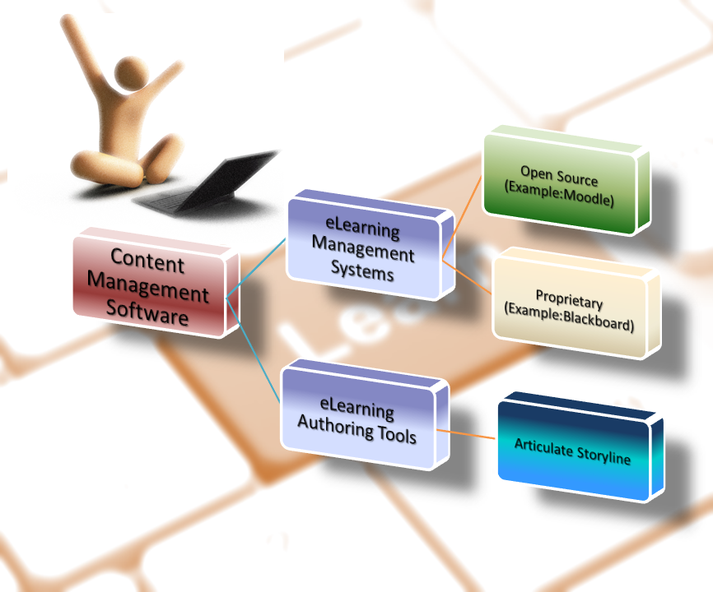

Slide 11
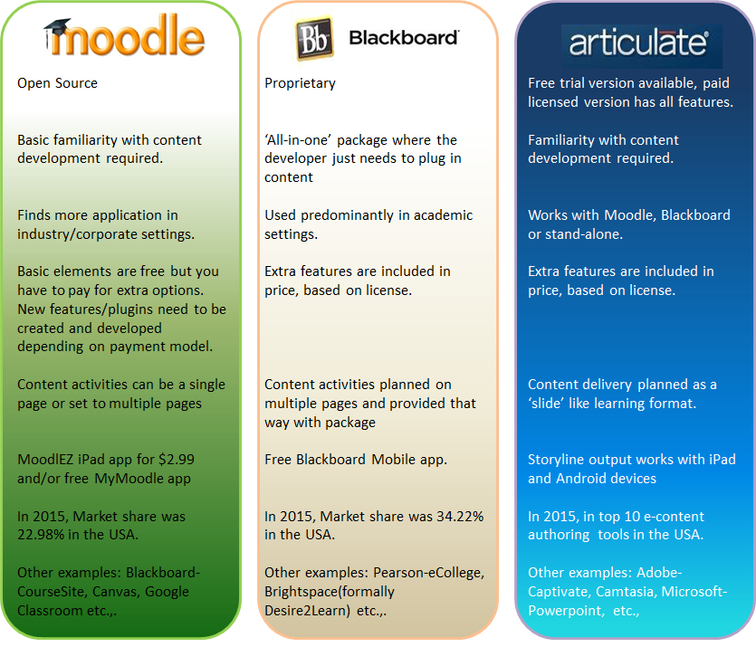

Slide 12
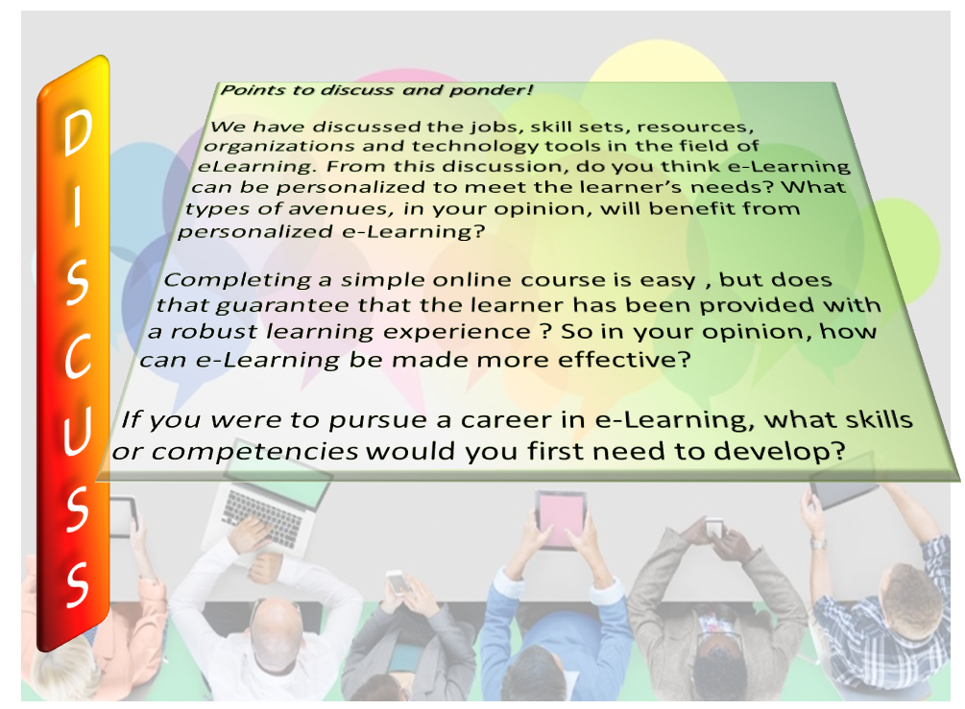

Slide 13

Resources
7 eLearning Specialties That Are On The Rise. (n.d.). eLearning Industry. [Blog Post]. Retrieved from http://elearningindustry.com/7-elearning-specialties-rise
AYSO - Torrance, CA (n.d.) Indeed. Retrieved from http://www.indeed.com/cmp/AYSO/jobs/Elearning-Developer-71bd4d2934bc0496?q=Instructional+Designer+elearning
Clarity Consultants (n.d.) Monster.Retrieved from http://jobview.monster.com/eLearning-Instructional-Designer-Job-Jacksonville-FL-US-162839383.aspx?mescoid=2500399001001&jobPositio
How To Get Prepared For The eLearning Job Interview Questions. (n.d.) eLearning Industry. [Blog Post]. Retrieved from http://elearningindustry.com/how-to-get-prepared-for-the-elearning-job-interview-questions
Instructional Designer (2016, January 27). Penn State University. Retrieved from https://psu.jobs/job/61703
International eLearning Market Research. (n.d.) Ambient Insight Research. Retrieved from http://www.ambientinsight.com/Reports/eLearning.aspx
Learning Solutions Magazine (n.d.). Retrieved from http://www.learningsolutionsmag.com/articles/1092/new-ebook-62-tips-on-effective-elearning-instructional-design?_ga=1.143563637.1134161332.1454111632
McCarthy, J.P. (2015, November 18). Three Sectors Driving the Multi-Billion e-Learning Phenomenon. Taxamo. [Blog Post] Retrieved from https://www.taxamo.com/three-sectors-driving-the-multi-billion-elearning-phenomenon/
Moodle vs BlackBoard – That is the Question (2015, August 27). iSpring. [Blog Post]. Retrieved from http://www.ispringsolutions.com/blog/moodle-vs-blackboard/
Thompson, L.T. & MacDonald. J.C. (2005) Community building, emergent design and expecting the unexpected: Creating a quality eLearning experience.The Internet and Higher Education. 8(3). pp 233-249. Retrieved from http://www.sciencedirect.com/science/article/pii/S1096751605000369

